Slide 1

TOURISM THROUGH TRAVEL
Shannon welborn, kevin cross, & Dwight larkins

Slide 2

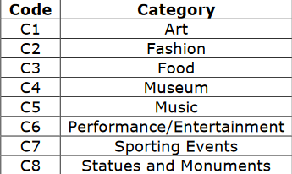
Tourism through travel club REQUIREMENTS
Creation of database to track employee information, customer information, and information about trips
Functions to reserve trips in cities around the world and track those reservations
Free VS Premium membership
Input forms (For example: Employee Information)
Needs to be lean and follow good industry standards wherever possible

Slide 3
Our work
https://docs.google.com/spreadsheets/d/1MB8TwIOK3uF3LseW7L7sulrvhjEb_42bI6SS7u0YVb0/edit#gid=0 <- Data Dictionary
https://docs.google.com/document/d/1mRWUwGX1HBCjOmqdGbNeJ7sVHNg8015p4KsGci1LwQY/edit <- SQL Code
Mockup form: Attraction
Mockup form: Payment Entry
Mockup report: Member Receipts

Slide 4
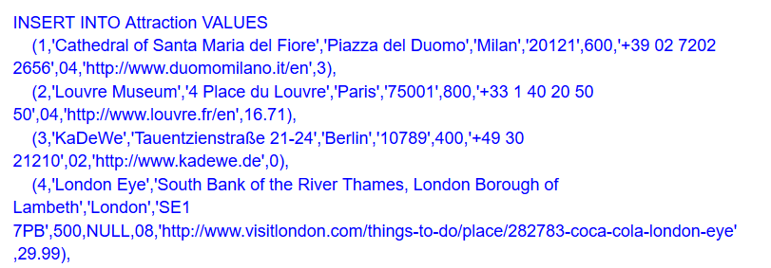
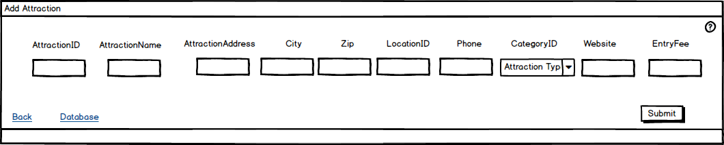
Example form: ‘Attraction’

Slide 5
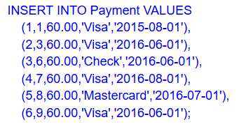
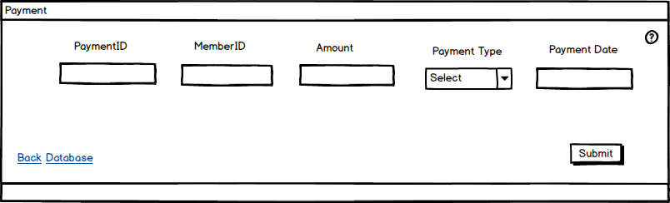
Example Form: ‘Payment entry’

Slide 6
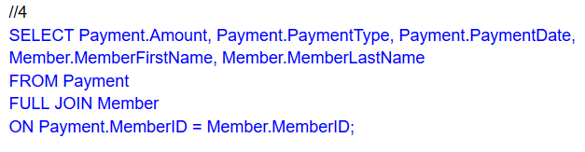
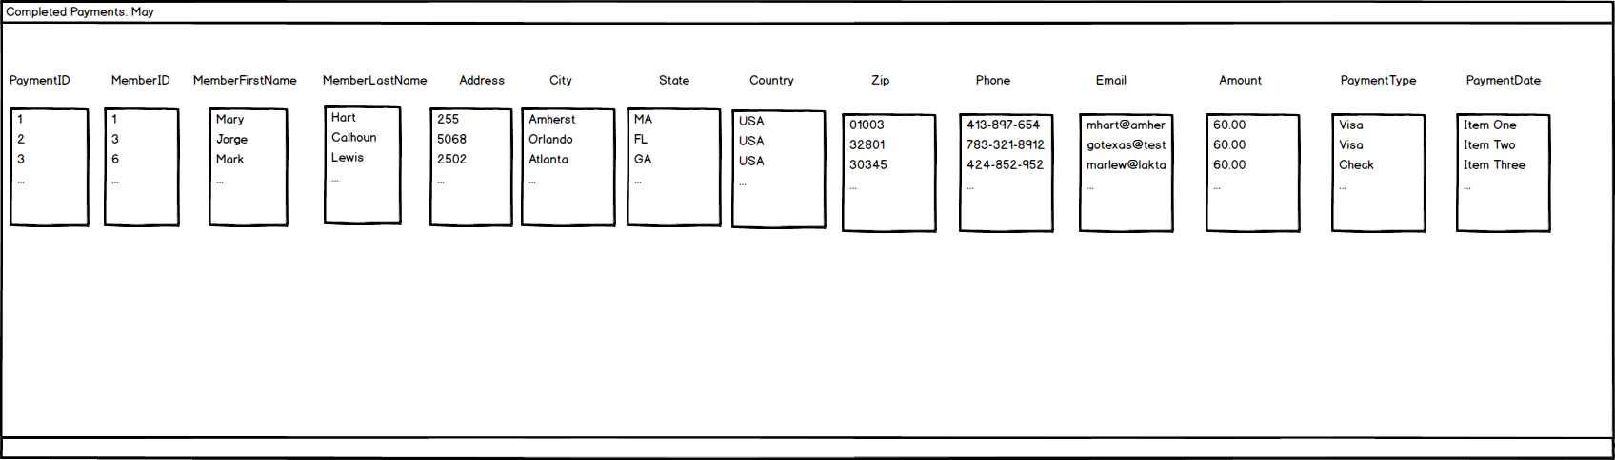
Example report: #4: Member receipts

